Slide 1
Decisions CS 110 - Introduction to Programming
Brother W. Clements

Slide 2
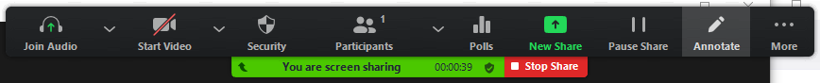

Review
What do we know about?
Displaying things to the screen?
Getting input from the user?
Strings?
Integers?
Floats?
Libraries?
Comments?
Variable Names?
Zoom Annotations
Spotlight
Stamp
Text

Slide 3
Output
Comments
Strings
Libraries
Floats
Input
Coding Standards (Variable Naming)
Integers

Slide 4
Review
Output
print (<string>)
print (“….{}”.format(<var>))
print (f”…{<var>})
Input
Var = input(<string>)
<Strings>
+
str(<var>)
Functions: .capitalize, .lower, .upper, .title, .count
Integers
+, operators (add, sub, mult, div, whole, remainer, exp
int(<var>)
Floats
+, operators (
float(<var>)
Libraries - import
Math: ceil, floor, exp, sin
Comments
In-line, block,
Variable Name
underscore
What do we know about?
Displaying things to the screen?
Getting input from the user?
Strings
Integers
Floats
Libraries
Comments
Variable Names

Slide 5

Prepare
Kahoot Quiz: cse110-05-2 Conditionals

Slide 6
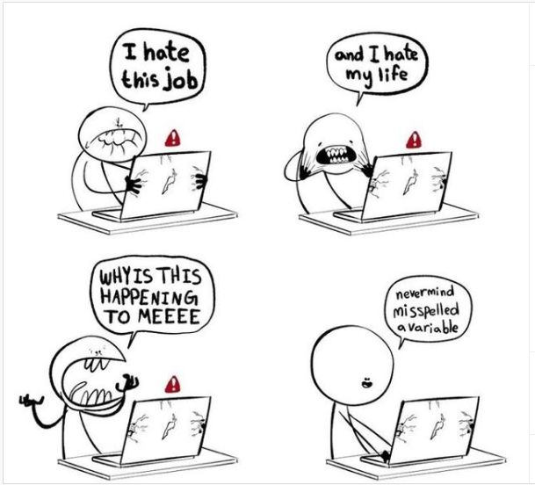
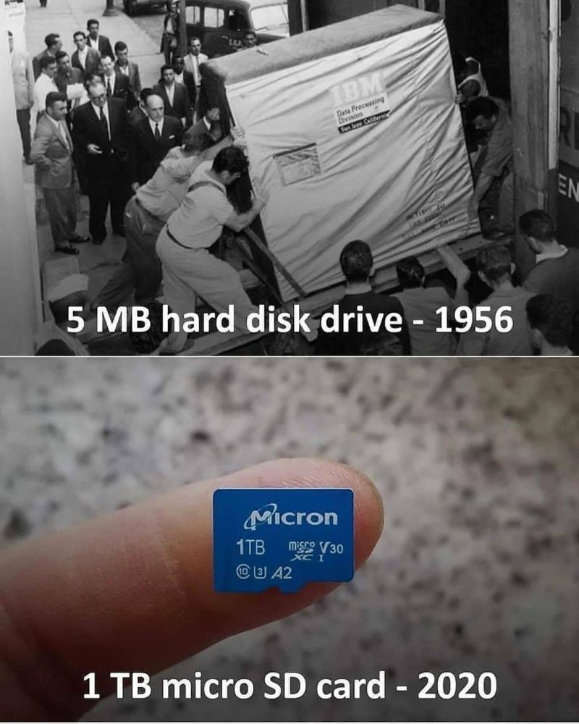
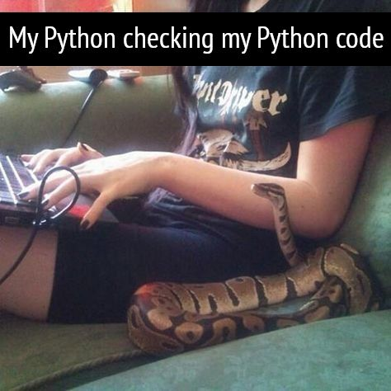

Slide 7

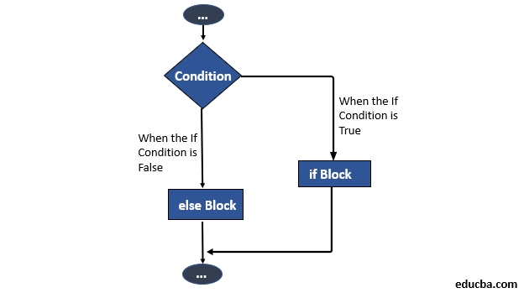
Prepare
Questions about
Conditional Statement
if <condition> : then_stuff_goes_here
else: then_stuff_goes_here
if <condition> : then_stuff_goes_here
elif <condition> : then_stuff_goes_here*
else: then_stuff_goes_here
Conditions
True or False equation
== equivalent, not assign (=)
Works for strings, but remember case
> greater than
< less than
in statement

Slide 8
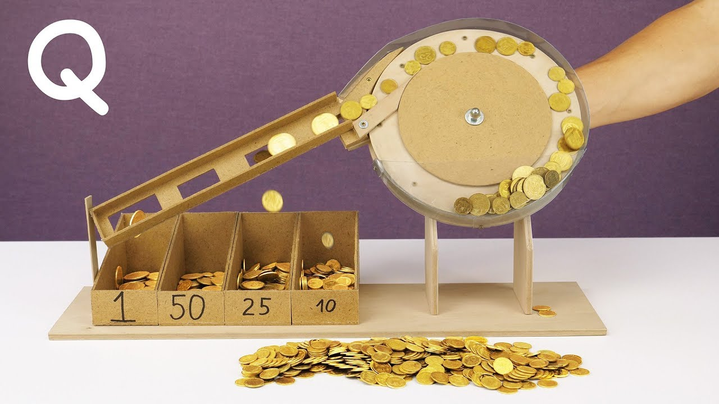
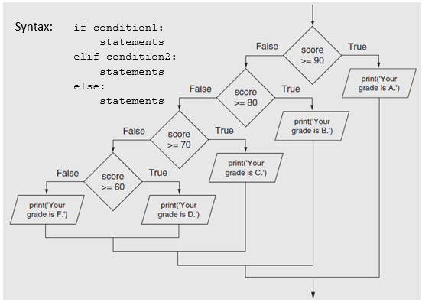
Differences
Multiple single ifs
Use of if, elif, else
coin = input(“Enter coin value”)
coin_value = int(coin)
new_value = -1;
if coin == 25: new_value = .25
if coin == 10: new_value = .10
if coin == 5: new_value = .05
if coin == 1: new_value = .01
coin = input(“Enter coin value”)
coin_value = int(coin)
new_value = -1;
if coin == 25: new_value = .25
elif coin == 10: new_value = .10
elif coin == 5: new_value = .05
elif coin == 1: new_value = .01
else new_value = 0

Slide 9
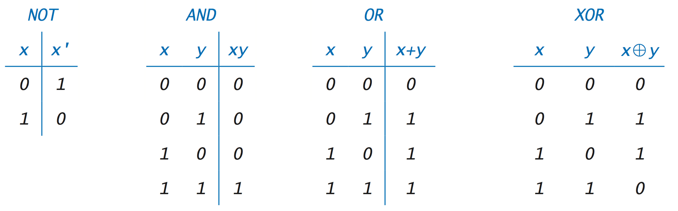
Expressions
How do you know if you spouse is a programmer?
Send them shopping and tell them: "Get a loaf of bread and if they have eggs get 10." If they comes back with 10 loaves of bread
If statement only take the results of expressions, True or False
Use AND or OR to evaluate multiple expression in to on.
For Example
You are ask to get Milk AND Bread, if you don’t bring home both, then FALSE
You are asked to get White OR Brown bread, either will work. If you bring home cake then it is FALSE.

Slide 10


Checkpoint
What is the first number? 4
What is the second number? 3
The first number is greater
The numbers are not equal
The second number is not greater
What is your favorite animal? giraffe
That one is not my favorite..
Steps
Read instructions - Practicing If Statements
3 if/else statements
1
The first number is greater
The first number is not greater
2
The numbers are equal
The numbers are not equal
3
The second number is greater
The second number is not greater
Compare String
That's my favorite animal too!
That one is not my favorite.
Attempt coding the problem for 1 hour
Look at the Instructor code after 1 hour or when done.
Include in notes, what you learned from the instructor's code
What is the first number? 1009
What is the second number? 5250
The first number is not greater
The numbers are not equal
The second number is greater
What is your favorite animal? bear
That's my favorite animal too!
What is the first number? 42
What is the second number? 42
The first number is not greater
The numbers are equal
The second number is not greater
What is your favorite animal? BEAR
That's my favorite animal too!

Slide 11

Teach: Team Activity
Meet and setup a video call, share screen
Overview
Grade Calculator
A >= 90
B >= 80
C >= 70
D >= 60
F < 60
Use if-elif-else
Core requirements
Must have the core requirements
Ask user
Determine Letter grade, indicate if passed the class
Use variables and only 1 print
Stretch Challenge
Add +/- to score, single print, see hint
Account for No A+
Account for No F+ or F-
Teacher Solution
Submission
In notes tell me what you learned from the teacher solutions.

Slide 12
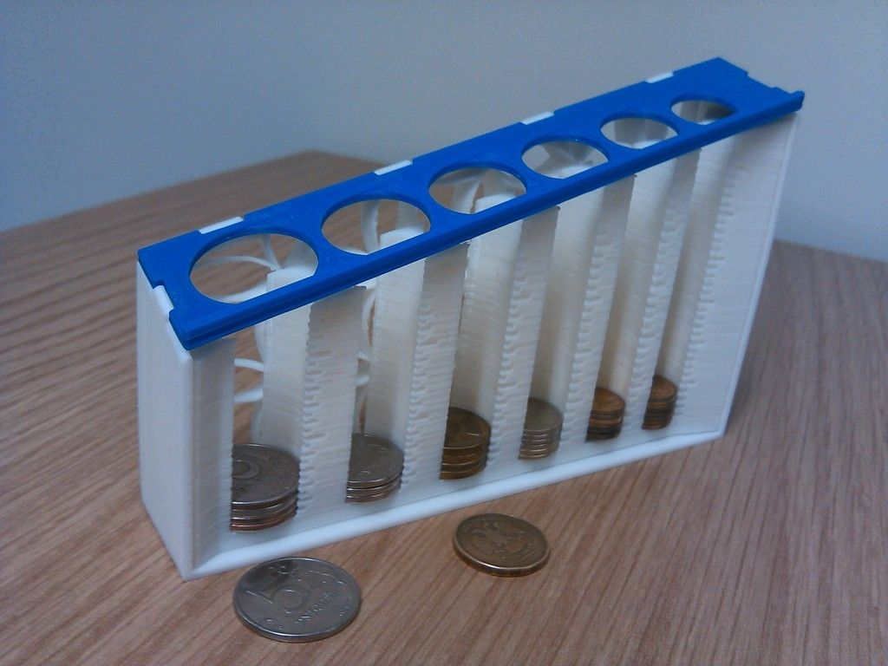
D-
F+
D-
D+
C-
C+
B-
B+
A-
A+
90
A
80
B
70
C
F
60
D

Slide 13
Prove
Remember: We're Going on a Bear Hunt!
Overview
In a text-based adventure game, the user is presented a scenario with different options. Depending on the option they choose, they have different consequences, which in turn present different choices for the next action
Program the following:
three levels of scenarios with possible choices. Comment Scenarios
At least one of your scenarios must have more than two possible choices.
In each prompt, write the choices in ALL CAPS,
When checking the user's responses, you should match on the keyword
Making different choices should take you to different scenarios
Choices should only work for the correct question.
In other words, if one scenario resulted in choices of Run/Hide, but another resulted in choices Follow/Look, you should not be able to respond with "Follow" to the question that asked for Run/Hide.
A good way to accomplish this is to have a series of nested if statements. (That is, the print and then the next if statement will be within the body/block of the first if statement.)
For each question, you should provide an "else" clause to handle the case that the user tries to type something other than the possible choices. It is up to you how to handle this case.
Make it your own
Submission
Upload program (the .py file) to the assignment
Submission Comment: What you think you did and 1-2 sentences justify your that describes your effort
1 = Some attempt made, 2 = Developing (but significantly deficient), 3 = Slightly deficient, 4 = Meets requirements, 5 = Made it your own
You are walking through a dark forest and find two items: a MATCH and a FLASHLIGHT. Which one do you want to pick up?
match
You pick up the match and strike it, and for an instant, the forest around you is illuminated. You see a large grizzly bear, and then the match burns out. Do you want to RUN, or HIDE behind a tree?
flasHliGht
You pick up the flashlight and turn it on. You see the pathway lit up in front of you, but you thought you also heard something off to the side. Do you want to FOLLOW the path or LOOK in the trees for the thing that made the noise?

Slide 14
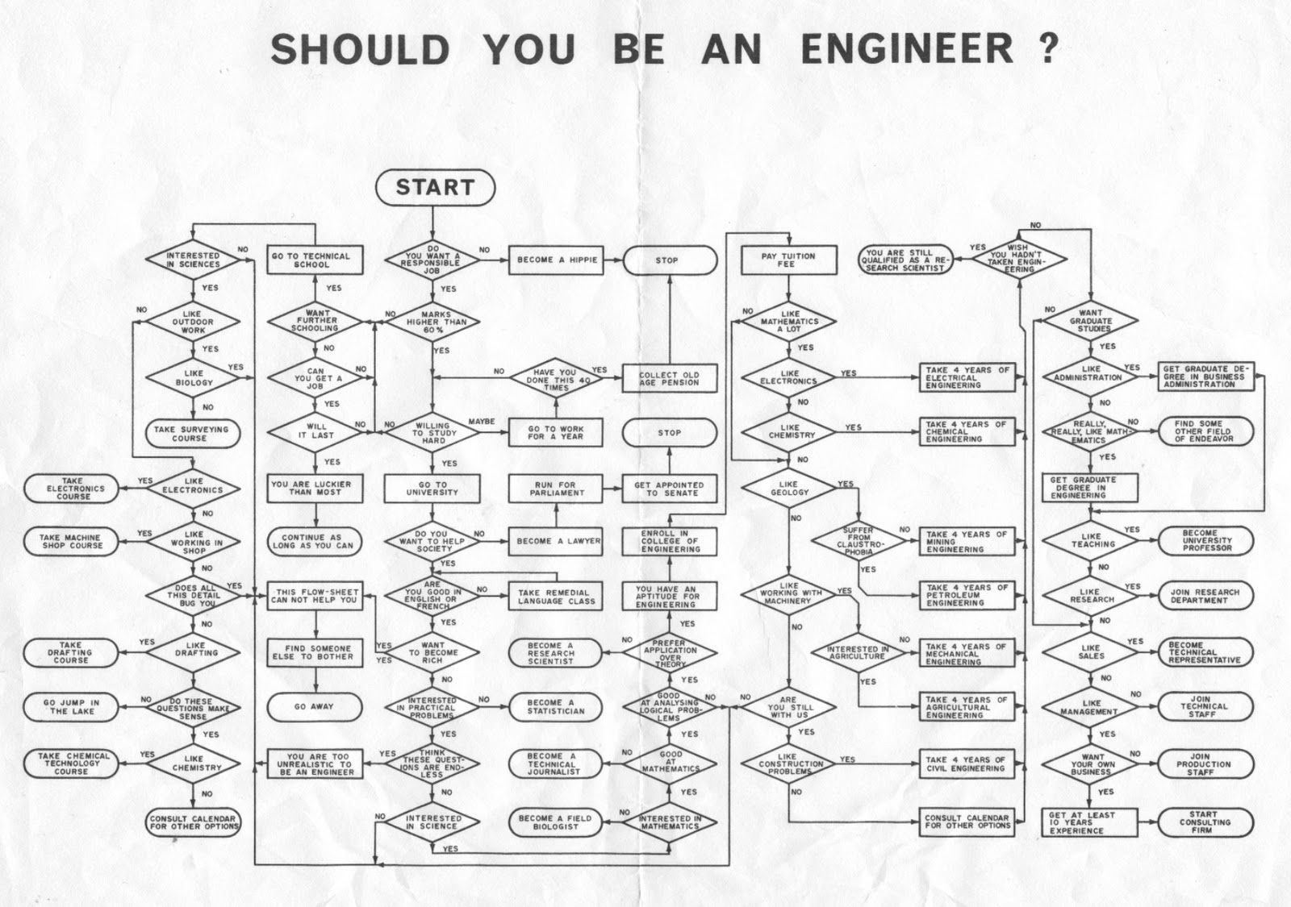

Slide 15
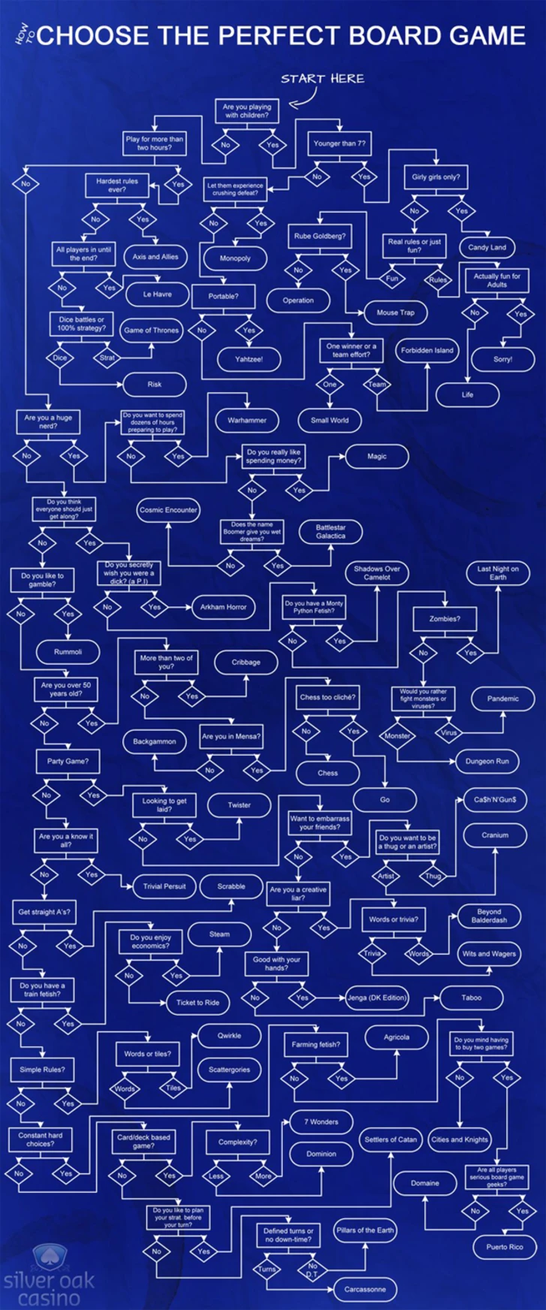
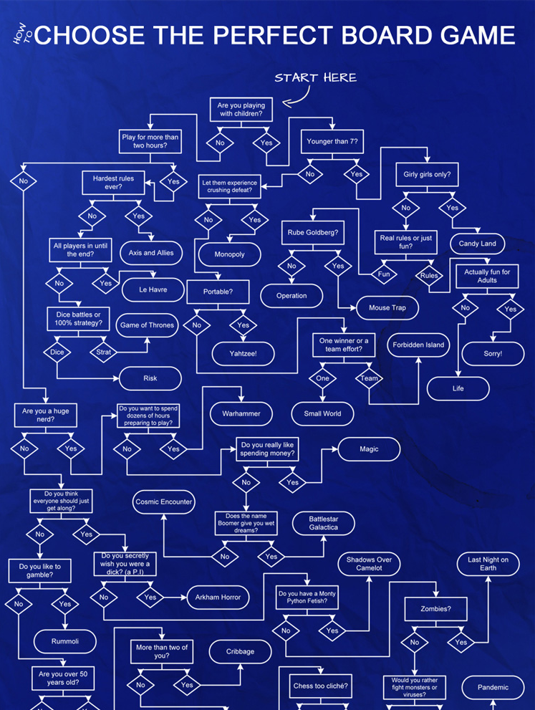
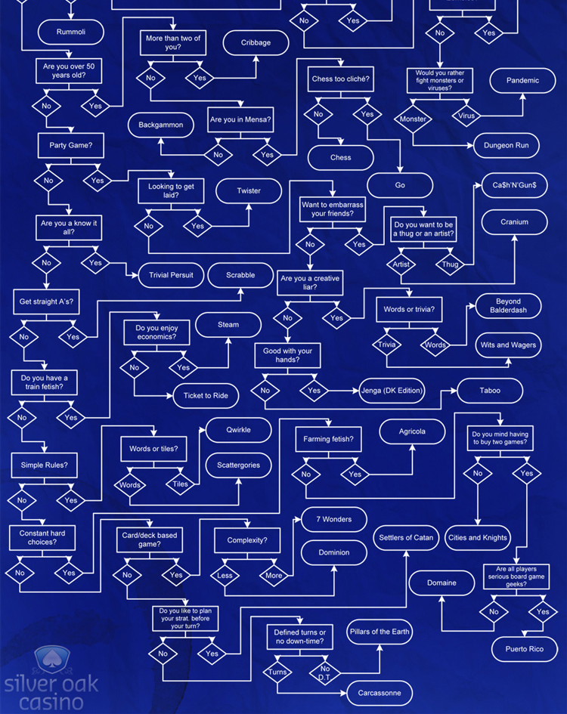

Slide 16
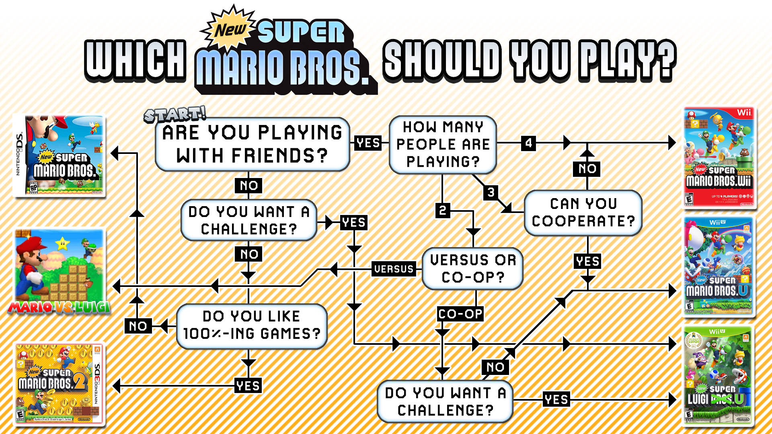
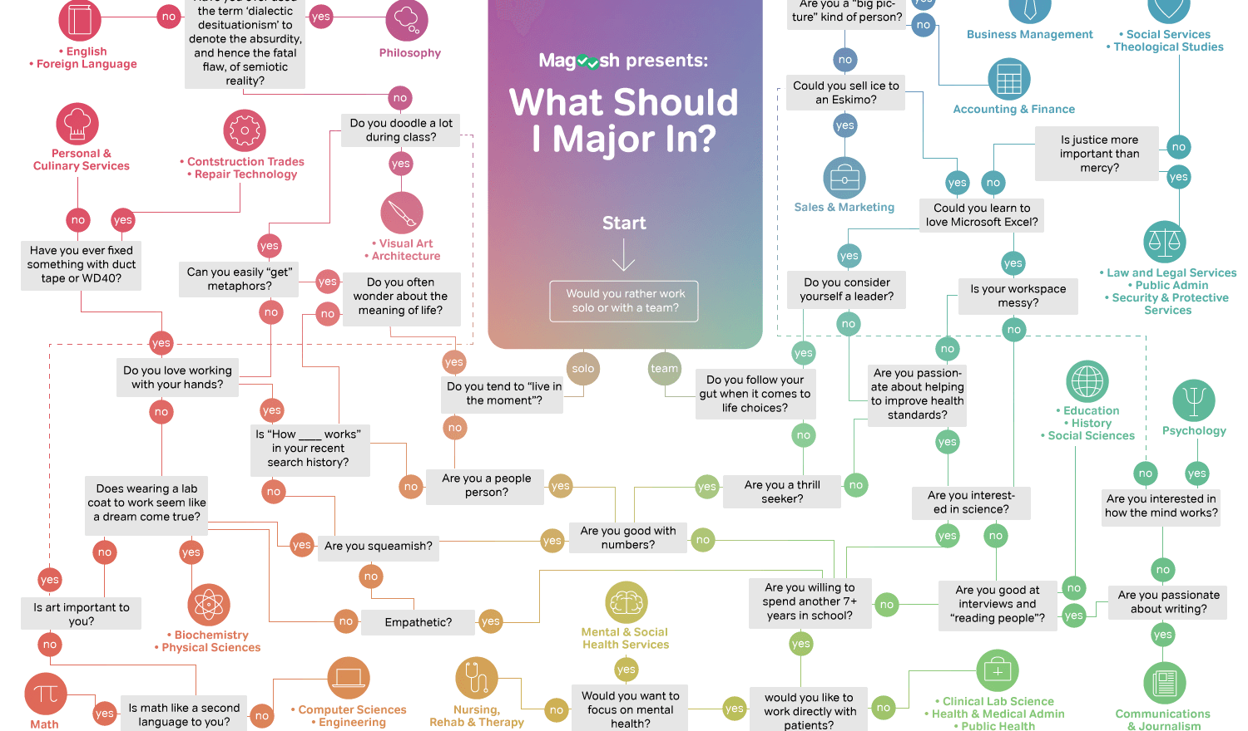
Notes:
http://www.cs.put.poznan.pl/amichalski/PWSZ/systemy/propozycje/

